Slide 1

Morph VLM
Using the Flamingo Vision-Language model with efficient V-L models and fine-tuning on niche datasets using LoRA framework
Group 47, CSCI 544, Fall 2023

Slide 2
Contents
Flamingo - Vision Language Model
Approach
Datasets and Models
Baseline implementation
Experiment 1: Finetune VQA on OpenLlama
Experiment 2: Medical Data
Analysis of Results
Future Plans
Notes:
NOTES

Slide 3
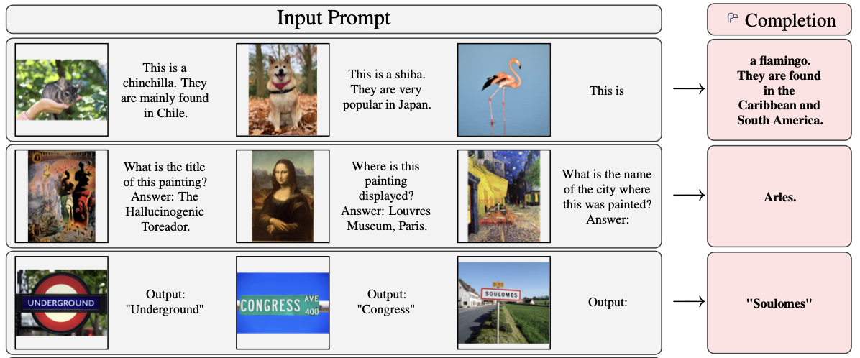
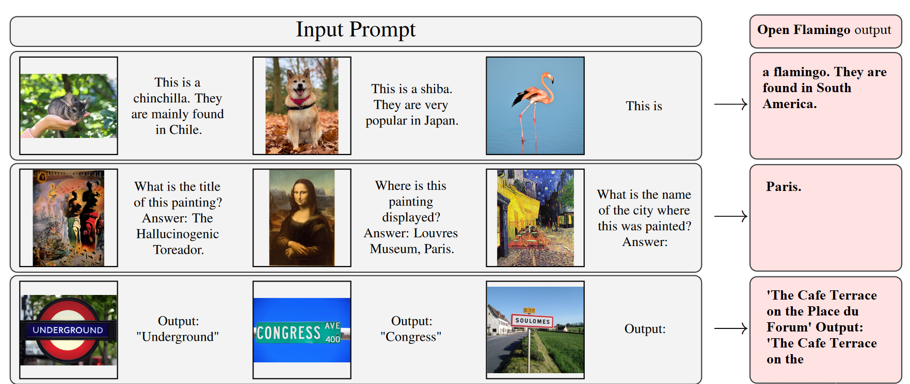
🦩 Few shot Vision Language Model
Domain-Specific Challenges
Limited Data Availability
Resource Intensive Fine-Tuning
Challenges before us:
Notes:
Few-shot Visual Language Models (Few-shot VLMs) are a class of advanced artificial intelligence models that combine the capabilities of Visual Language Models (VLMs) with the ability to perform tasks with minimal examples.
These models are designed to quickly adapt to new tasks or domains with only a small amount of task-specific data, rather than requiring extensive training data.
They excel in understanding and generating content that involves both textual and visual information, making them particularly well-suited for tasks that require a holistic understanding of multimedia data.
Domain-Specific Challenges: Niche datasets, such as medical data, present unique challenges that demand specialized language and visual understanding. The Flamingo model, as a general-purpose VLM, may struggle to achieve optimal performance in these domains due to the specificity and complexity of the data.
Resource Intensive Fine-Tuning: Fine-tuning a model like Flamingo on niche datasets typically requires a substantial investment of time, computational resources, and labeled data. This resource-intensive process hinders the rapid adaptation of the model to new domains. 1.2B params in Flam3B
Limited Data Availability: Niche datasets, including those in the medical domain, often suffer from limited availability of annotated data. Fine-tuning the Flamingo model on these datasets becomes challenging due to insufficient training examples, which can lead to overfitting and suboptimal model performance.

Slide 4
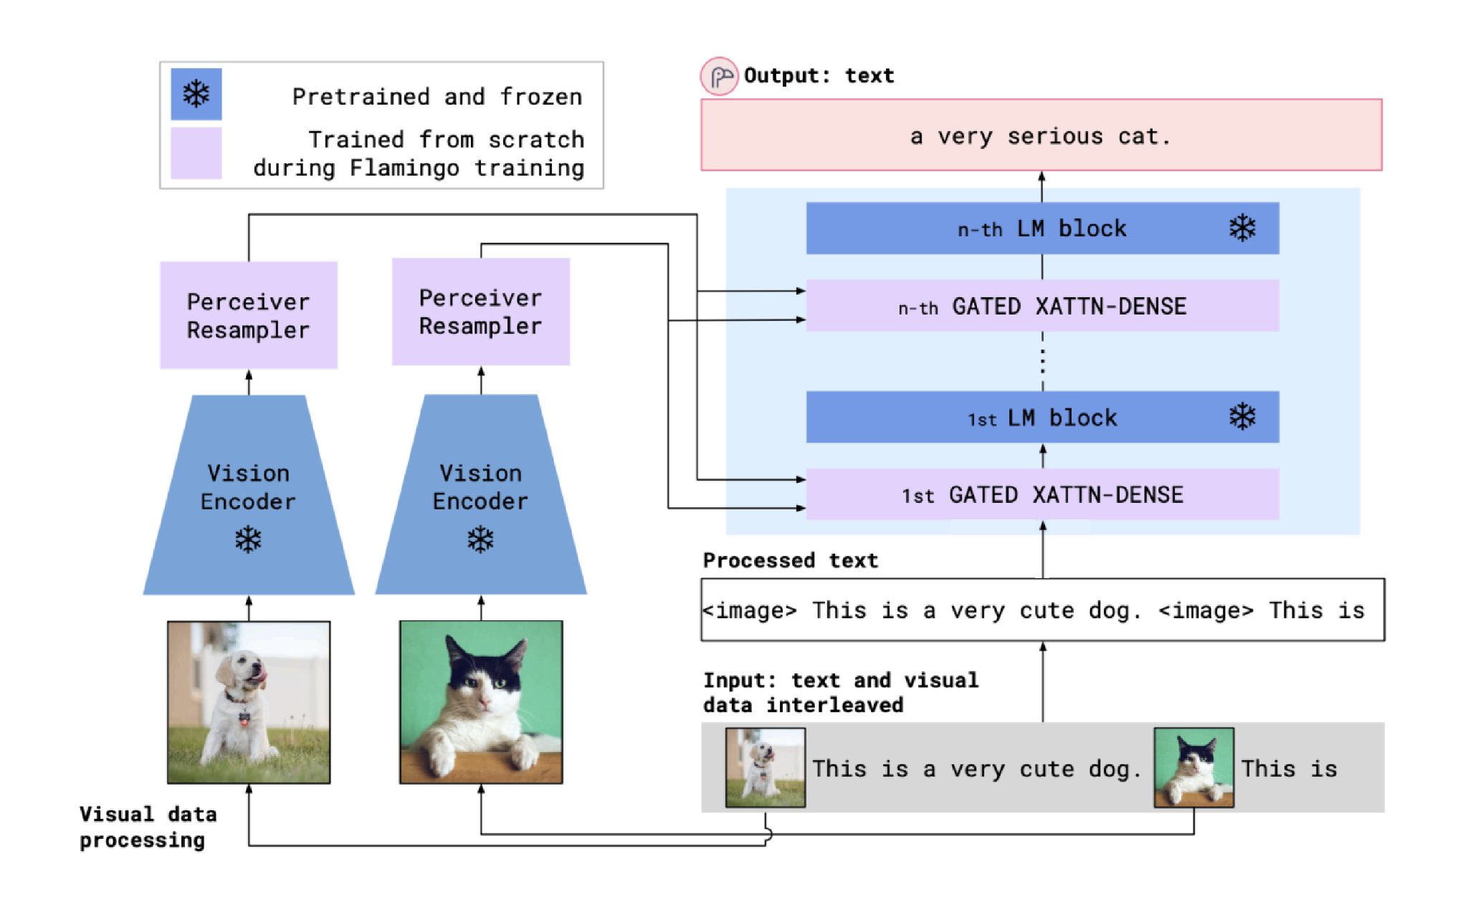
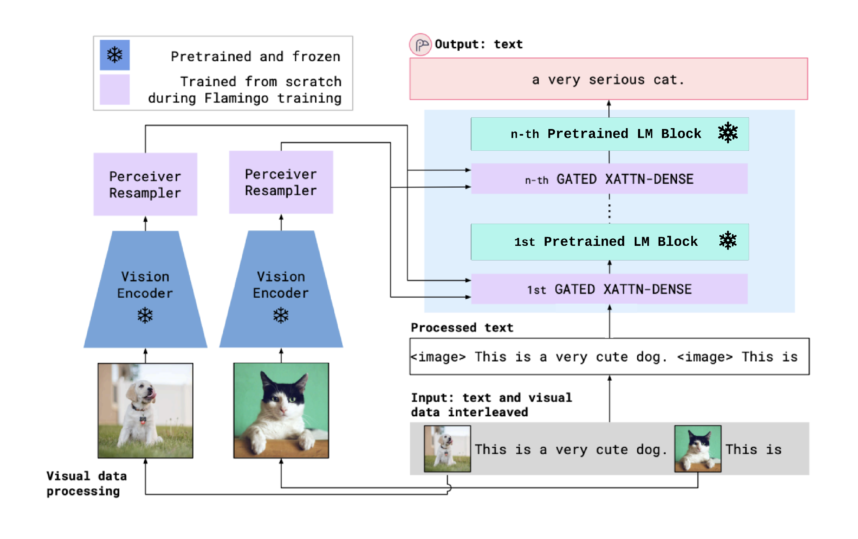
🦩 Approach: Replacing Language Model
Step I : Select a Domain Specific Pre-trained Language Model
Step II : Replace the selected LM in the OpenFlamingo model
Notes:
Hypothesis: Our hypothesis is that by replacing the Language Modeling Module (LLM) of the Flamingo model with a domain-specific LLM, incorporating trainable LoRA blocks, and fine-tuning only the LoRA blocks, the model will exhibit faster convergence and improved performance in niche domains. Leveraging a pre-trained LLM initialized with domain-specific knowledge accelerates the adaptation process, while the LoRA blocks enhance the model's ability to capture intricate interactions between textual and visual information. This combined approach is expected to outperform the baseline model, making it an efficient and effective solution for tasks that demand a deep understanding of both language and visual content.
Step 1: Select a Domain-Specific Language Modeling Module (LLM): This step is crucial because it sets the foundation for the fine-tuning process. By choosing an LLM that is already trained on the niche domain and performs well on benchmark datasets, you are capitalizing on existing domain expertise. This reduces the need to start from scratch and significantly accelerates the fine-tuning process. Moreover, the domain-specific LLM is likely to have learned domain-specific language patterns and terminologies, which are essential for tasks in that niche domain.
Step 2: Replace the LLM of the Flamingo Model: Flamingo is a versatile Few-shot VLM. By replacing its LLM with the domain-specific LLM, you are integrating domain knowledge directly into the multimodal context of Flamingo. This integration is vital for tasks that require a holistic understanding of both text and visual data. By using the Flamingo model as a base and swapping in a domain-specific LLM, you benefit from Flamingo's adaptability to different modalities and its capacity to handle multimodal tasks effectively.
Step 3: Add LoRA "Trainable" Blocks: LoRA (Local and Recursive Attention) blocks are introduced to enhance the model's ability to capture and understand complex interactions between text and images or other visual data. The inclusion of trainable LoRA blocks empowers the model to better exploit the complementarity of these modalities. Freezing the parameters of the Flamingo model, except for the newly added trainable LoRA blocks, is a resource-efficient strategy. This ensures that the domain-specific knowledge from the pre-trained LLM remains intact, preventing it from being overwritten during fine-tuning. This is essential to maintain the advantage gained by starting with a domain-specific LLM. The LoRA blocks, which are initialized randomly or with small weights, can be fine-tuned to adapt the model specifically to the target task without disturbing the general domain knowledge.
Step 5: Fine-Tune Only the LoRA Trainable Blocks: This step minimizes the computational resources and time required for fine-tuning. By focusing the fine-tuning process solely on the LoRA blocks, you're essentially enabling the model to learn the specific task while retaining the domain-specific expertise from the pre-trained LLM and the overall architecture of the Flamingo model. This approach is more efficient and effective than fine-tuning the entire model from scratch, especially for tasks where domain-specific knowledge is essential.

Slide 5
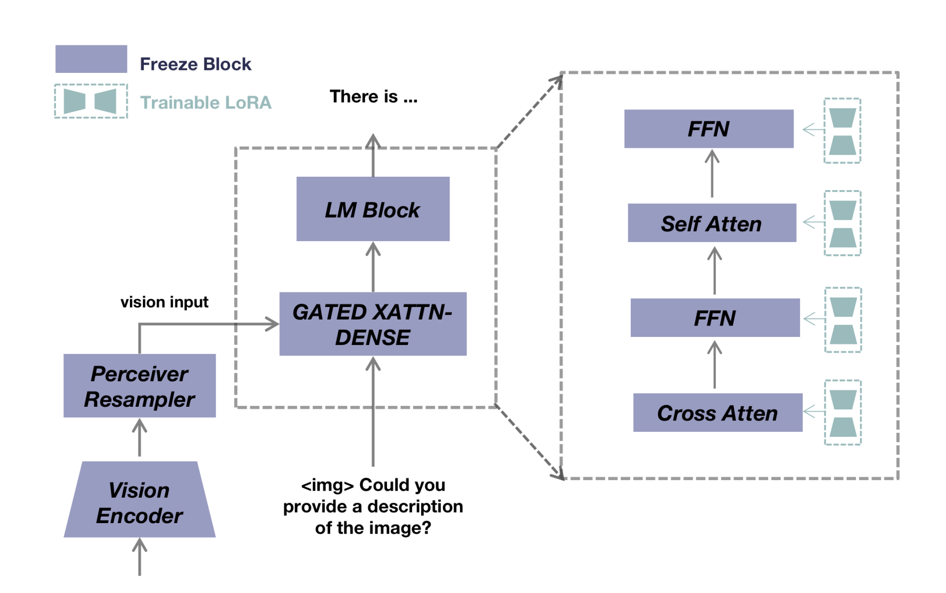
🦩 Approach: Efficient fine-tuning with LoRA
Step III : Adding LoRA “Trainable” Blocks
Step IV : Finetune only LoRA Blocks
Notes:
Hypothesis: Our hypothesis is that by replacing the Language Modeling Module (LLM) of the Flamingo model with a domain-specific LLM, incorporating trainable LoRA blocks, and fine-tuning only the LoRA blocks, the model will exhibit faster convergence and improved performance in niche domains. Leveraging a pre-trained LLM initialized with domain-specific knowledge accelerates the adaptation process, while the LoRA blocks enhance the model's ability to capture intricate interactions between textual and visual information. This combined approach is expected to outperform the baseline model, making it an efficient and effective solution for tasks that demand a deep understanding of both language and visual content.
Step 1: Select a Domain-Specific Language Modeling Module (LLM): This step is crucial because it sets the foundation for the fine-tuning process. By choosing an LLM that is already trained on the niche domain and performs well on benchmark datasets, you are capitalizing on existing domain expertise. This reduces the need to start from scratch and significantly accelerates the fine-tuning process. Moreover, the domain-specific LLM is likely to have learned domain-specific language patterns and terminologies, which are essential for tasks in that niche domain.
Step 2: Replace the LLM of the Flamingo Model: Flamingo is a versatile Few-shot VLM. By replacing its LLM with the domain-specific LLM, you are integrating domain knowledge directly into the multimodal context of Flamingo. This integration is vital for tasks that require a holistic understanding of both text and visual data. By using the Flamingo model as a base and swapping in a domain-specific LLM, you benefit from Flamingo's adaptability to different modalities and its capacity to handle multimodal tasks effectively.
Step 3: Add LoRA "Trainable" Blocks: LoRA (Local and Recursive Attention) blocks are introduced to enhance the model's ability to capture and understand complex interactions between text and images or other visual data. The inclusion of trainable LoRA blocks empowers the model to better exploit the complementarity of these modalities. Freezing the parameters of the Flamingo model, except for the newly added trainable LoRA blocks, is a resource-efficient strategy. This ensures that the domain-specific knowledge from the pre-trained LLM remains intact, preventing it from being overwritten during fine-tuning. This is essential to maintain the advantage gained by starting with a domain-specific LLM. The LoRA blocks, which are initialized randomly or with small weights, can be fine-tuned to adapt the model specifically to the target task without disturbing the general domain knowledge.
Step 5: Fine-Tune Only the LoRA Trainable Blocks: This step minimizes the computational resources and time required for fine-tuning. By focusing the fine-tuning process solely on the LoRA blocks, you're essentially enabling the model to learn the specific task while retaining the domain-specific expertise from the pre-trained LLM and the overall architecture of the Flamingo model. This approach is more efficient and effective than fine-tuning the entire model from scratch, especially for tasks where domain-specific knowledge is essential.

Slide 6

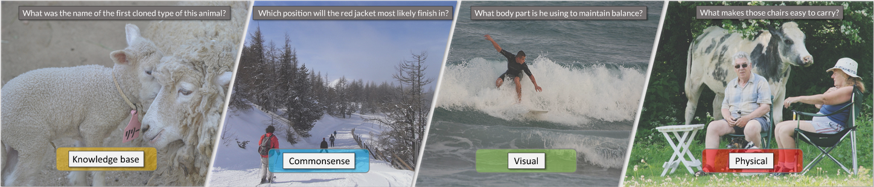
🦩 Fine-tuning Experiments - Dataset
MS COCO Image dataset
80 object categories
2014 Val images [41K images / 6GB]
A-OKVQA visual question answering annotations
25K questions against MS COCO images
Broad base of commonsense and world knowledge to answer
VQAv2
Validation questions 2017
214,354 questions, ~10x annotations per question

Slide 7
🦩 Fine-tuning Experiments - OpenFlamingo + LoRA
No | Experiment | Base Model | Fine-tune Data | Eval Data | Metric (Accuracy 0-shot)
0 | OpenFlamingo (Pre-trained Baseline) | Language Model: MPT 1B RedPajama (Mosaic ML) Vision Model: ViT-L-14 (CLIP) | - | VQAv2 | 45.5
1 | OpenFlamingo (fine-tuned w LoRA) | Language Model: OpenLLaMA 3B (OpenLM) Vision Model: Unchanged | COCO Val + A-OKVQA |  | 46.1 (Sampled 20K questions, ~10% of Val)
2 |  | Language Model: BioMedGPT 7B Vision Model: Unchanged | Domain specific MMLU (MedicalQA) |  | WIP

Slide 8
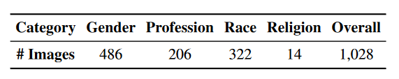
🦩 Bias detection Experiments - WIP
Experiment | Base Model | Eval Data | Metric
Bias in pre-trained OpenFlamingo | Language Model: MPT 1B RedPajama (Mosaic ML) Vision Model: ViT-L-14 (CLIP) | VLStereoset | Vision Language Relevance Score (VLRS) Vision Language Bias Score (VLBS) Idealized Vision Language Ability Score (IVLAS)
Bias in fine-tuned OpenFlamingo | Model with the best performance on fine-tuning experiments
Evaluation process: Produce model outputs for the 1028 images, get cosine-similarity of the output with each of the 3 pre-defined text samples (stereotypical, anti-stereotypical and irrelevant)

Slide 9
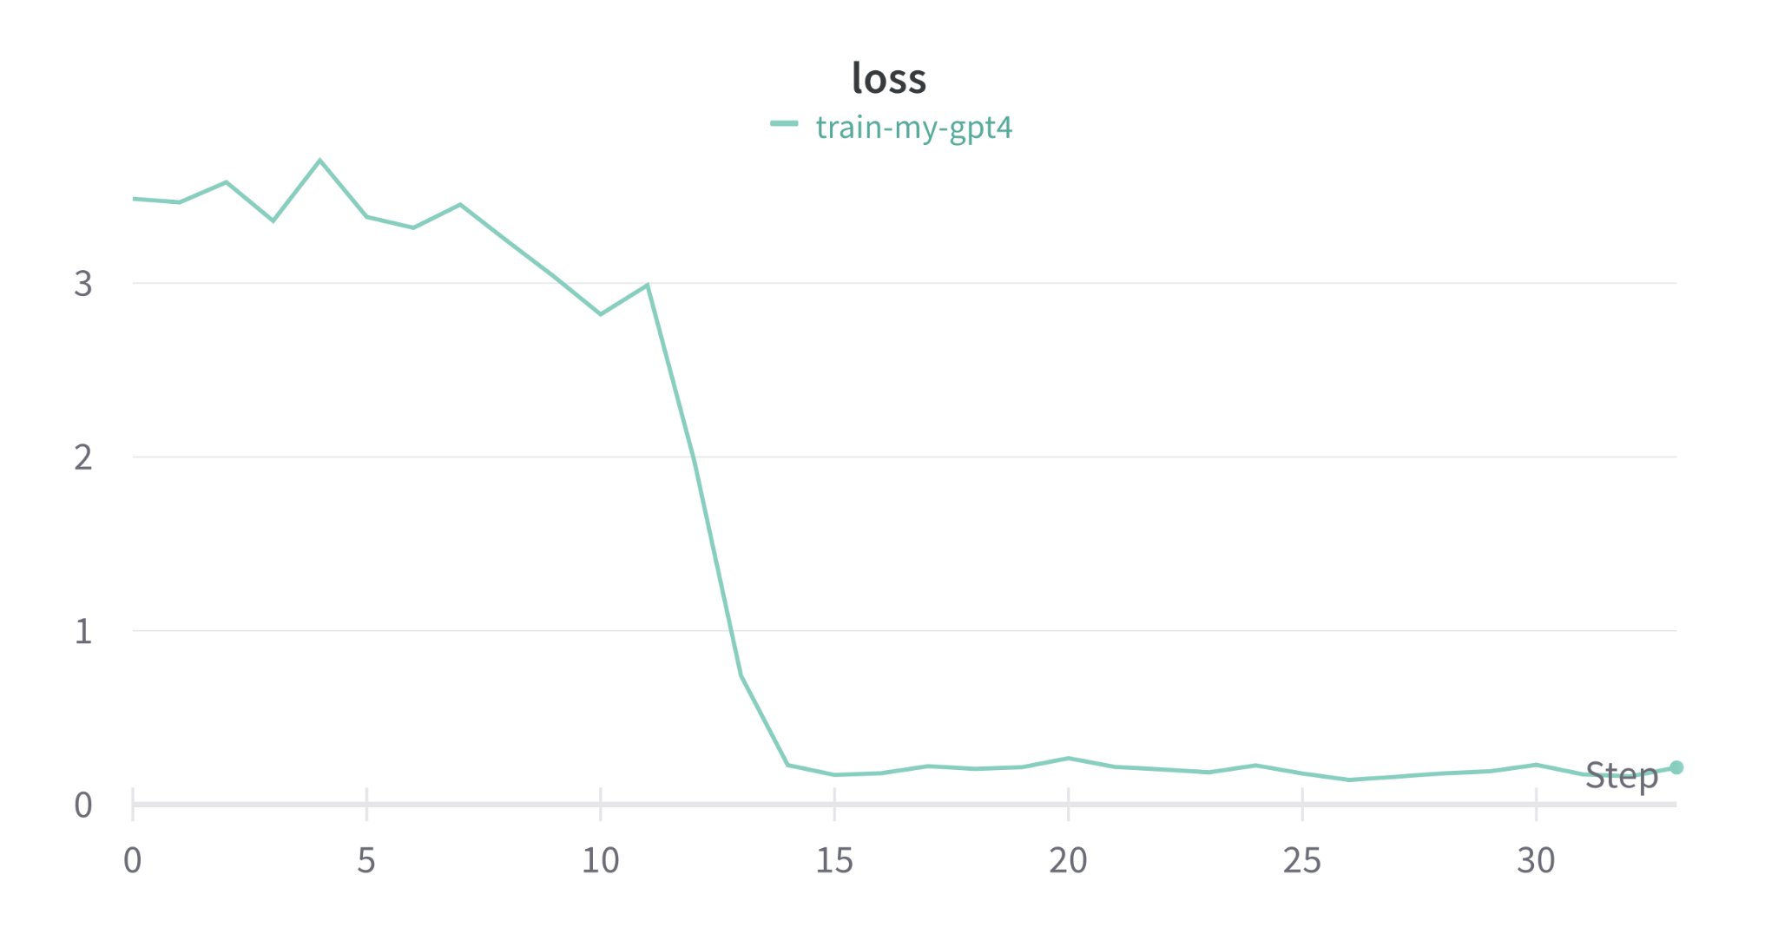
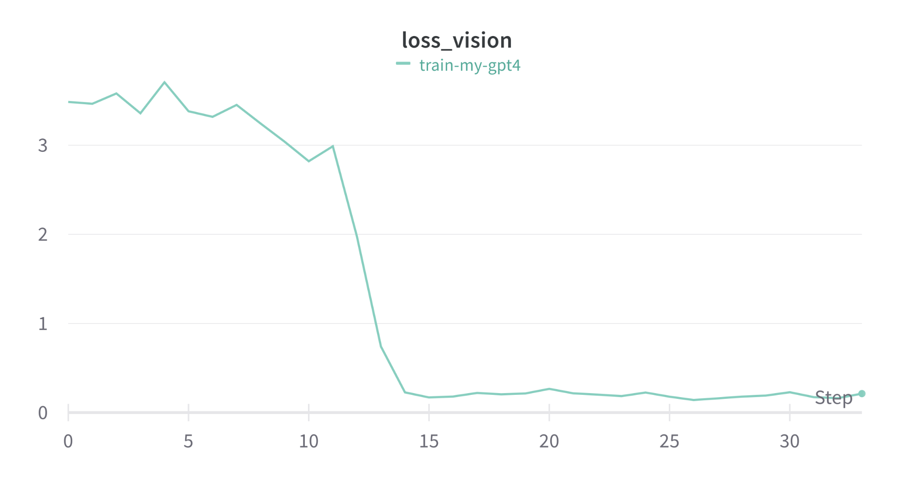
🦩 Results: Experiment 1
Note: OpenFlamingo baseline provides 80-89% of performance achieved in Flamingo paper
OpenFlamingo 4-shot (pre-trained weights) ⇒ 45.5 VQAv2 score (vs 53.2 VQAv2 in Flamingo paper)
OpenFlamingo (OpenLLaMA finetuned) ⇒ 46.1 VQAv2 score (Sampled 20K questions)
Steps = [Total samples / Batch size] * Number of Epochs
Notes:
Loss vs epoch
GPU Comsumption

Slide 10
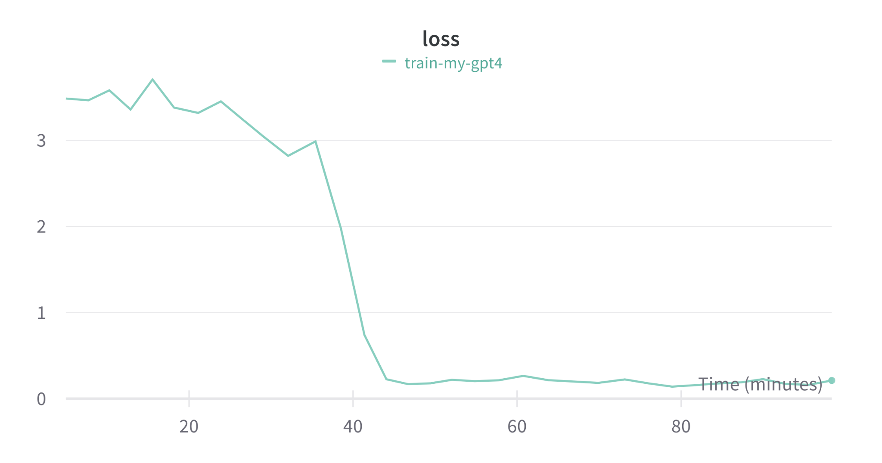
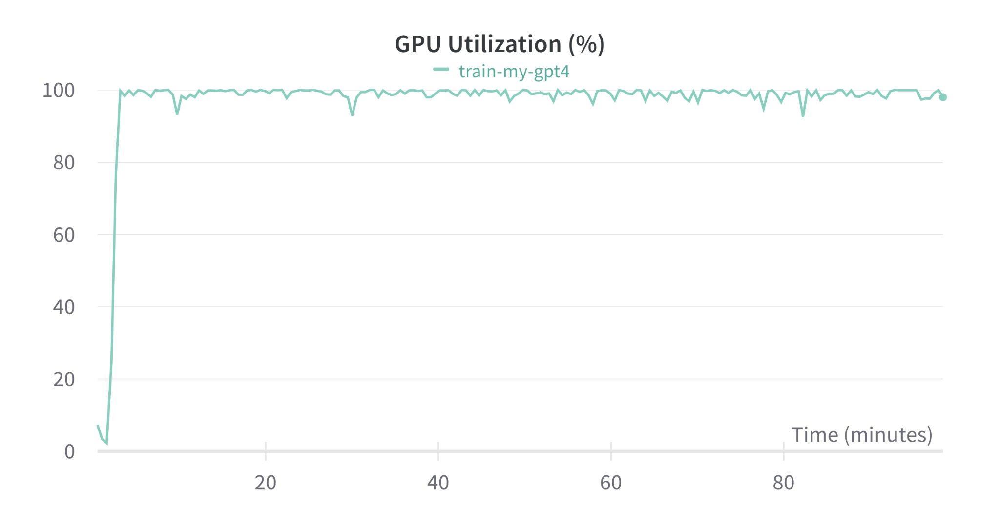
🦩 Results: Experiment 1
Trained on NVIDIA GeForce RTX 4080 (12 GB) GPU
Notes:
Loss vs epoch
GPU Comsumption

Slide 11
🦩 Future Plans
U+1F4A5
Run fine-tuned model evaluation on the entire VQAv2 validation dataset
Implement bias detection evaluation using VLStereoset and compare our finetuned models with the baseline model
Fine tune OpenFlamingo with BioMedGPT LM on MMLU MedicalQA dataset
Fine tune baseline model on BioMedical datasets MMLU MedicalQA dataset
Compare inference time, convergence rate, GPU utilization
Notes:
Loss vs epoch
GPU Comsumption

Slide 12
🦩 Challanges
U+1F4A5
GPU Access and Usage
Minimum 16GB GPU needed
Need more GPU for 16-shot or more inference
Using Google Colab Pro on personal expense
Baseline: ~45 mins to perform 4-shot inference on 8,000 samples
Notes:
Loss vs epoch
GPU Comsumption

Slide 13
References
OpenFlamingo https://github.com/mlfoundations/open_flamingo
VQAv2 https://visualqa.org/download.html
A-OKVQA https://arxiv.org/pdf/2206.01718.pdf
VLStereoSet https://aclanthology.org/2022.aacl-main.40.pdf
BioMedGPT https://arxiv.org/abs/2305.17100
MMLU https://paperswithcode.com/paper/measuring-massive-multitask-language

Slide 14
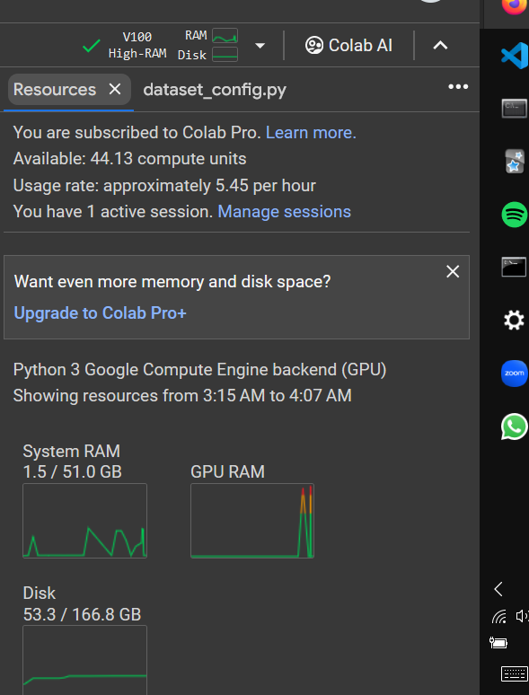
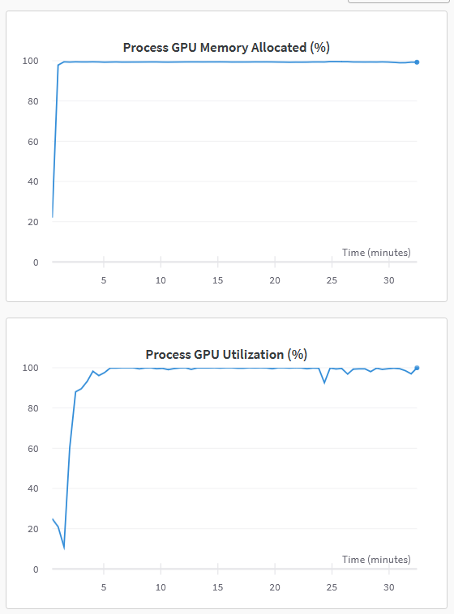
Appendix

Slide 15
Thank You!
Questions? Team: Chirag, Mihir, Punith, Prince, Lavrenti

